Slide 1
LINEAR REGRESSION

Slide 2
1. What is Linear Regression
Linear Regression is a supervised machine learning algorithm and a statistical method used to model the relationship between a dependent variable (target) and one or more independent variables (features) by fitting a linear equation to observed data.
It assumes that the relationship between variables can be represented by a straight line.

Slide 3
2. Purpose of Linear Regression
The purpose of Linear Regression is to:
Predict a continuous numerical value based on one or more input features
Model and quantify the relationship between independent variables and a dependent variable
Estimate how changes in input variables affect the output
Provide interpretable insights through coefficients (slope and intercept)
Serve as a baseline predictive model in regression problems
In simple terms: Linear Regression is used when the output is a real number and the relationship between variables is assumed to be linear.

Slide 4
3. Why it is Used
Linear Regression is used because it:
Predicts continuous numerical values
Quantifies the strength and direction of relationships
Is simple, interpretable, and fast
Serves as a baseline model for more complex algorithms

Slide 5
4. How Linear Regression Works
Takes input features X and output y
Assumes a linear relationship between them
Fits a line that minimizes the error between predicted and actual values
Uses optimization techniques (like Least Squares or Gradient Descent) to find best parameters
Produces predictions for new unseen data

Slide 6
5. Where it is Used
Linear Regression is used in:
Data Science
Machine Learning
Economics
Engineering
Business Analytics
Scientific Research

Slide 7
6. Formula
Simple Linear Regression: y = mx+c
Multiple Linear Regression: y = β0+β1x1+β2x2+⋯+βnxn
Where:
y = dependent variable
x = independent variable(s)
β0 = intercept
β1,β2,… = coefficients
m = slope
c = intercept

Slide 8
7. Technical Details
Assumptions:
Linearity
Independence of errors
Homoscedasticity (constant variance)
No multicollinearity
Normally distributed errors
Cost Function (Mean Squared Error):
J(θ) = 1/n∑i=1n(yi−y^i)^2
Optimization Methods:
Normal Equation
Gradient Descent
Evaluation Metrics:
R² Score
Mean Squared Error (MSE)
Root Mean Squared Error (RMSE)
Mean Absolute Error (MAE)

Slide 9
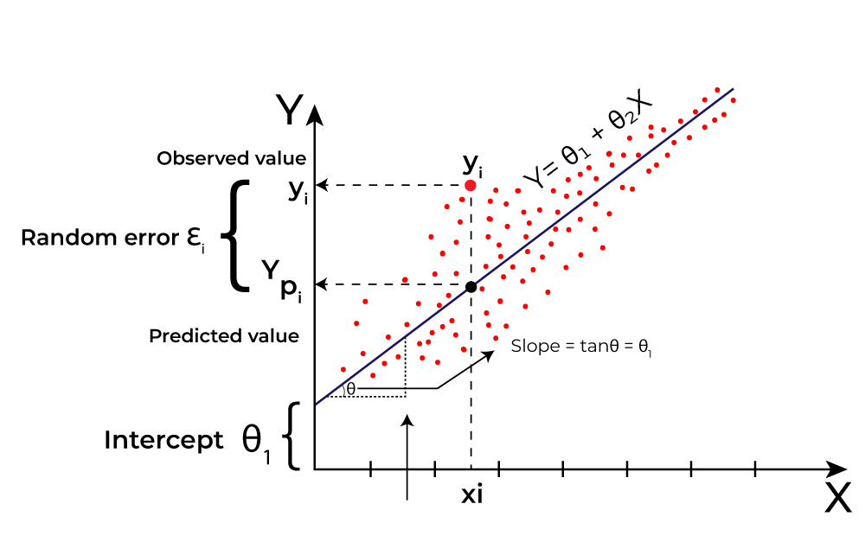

Slide 10
8. Pros
Easy to understand and implement
Highly interpretable results
Computationally efficient
Works well with small datasets
Useful for feature importance analysis

Slide 11
9. Cons
Assumes linear relationship
Sensitive to outliers
Poor performance with non-linear data
Requires assumptions to be satisfied
Multicollinearity affects stability

Slide 12
Finance:
Stock price trends
Risk assessment
Credit scoring
Engineering:
System performance prediction
Load and stress analysis
Social Sciences:
Population growth modeling
Income vs education studies
10. Real-World Applications
Business & Economics:
Sales forecasting
Price prediction
Demand analysis
Healthcare:
Predicting patient recovery time
Medical cost estimation

Slide 13
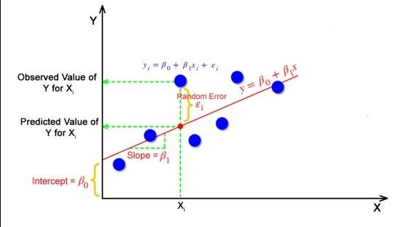
Summary
Linear Regression is a fundamental, interpretable, and powerful predictive model best suited for understanding relationships and making numeric predictions when data follows a linear pattern.

